Slide 1


PRESENTED BY AMAN JAIN P 4VM23CS002 PRIYANKA R 4VM23CS038
Vidya Vikas Institute of Engineering & Technology, Mysuru
Department of Computer Science and Engineering
Project on
WEB BASED ONLINE BLOOD DONATION SYSTEM
Under the guidance of
Prof. MEGHASHREE M B
Assistant Professor
Dept. Of CSE
VVIET
2025-2026

Slide 2
Vidya Vikas Institute of Engineering and Technology, Mysuru
Department of Computer Science and Engineering
CONTENTS
Introduction
Review of Literature
Problem Statement
Objectives
Methodology
Software and Hardware Requirements
Advantages
Expected Outcome
References
2025-2026

Slide 3
Vidya Vikas Institute of Engineering and Technology, Mysuru
Department of Computer Science and Engineering
INTRODUCTION
Blood is a critical resource required for surgeries, accidents, and medical treatments.
Timely availability of the right blood group can save lives.
Current systems are mostly manual, fragmented, and inefficient.
With digital transformation, there is a need for a centralized, real-time blood donation platform.
This project proposes a web-based system that connects donors, hospitals, and blood banks seamlessly
2025-2026

Slide 4
Vidya Vikas Institute of Engineering and Technology, Mysuru
Department of Computer Science and Engineering
REVIEW OF LITERATURE
S.No | Author Name | Year | Title of the Paper | Work Done | Future Scope
1 | Chirag Sharma, Vidhi Shah, Vedantika Singh | 2024 | BloodBond: Optimising Blood Bank System through a Comprehensive Smart Management System | Smart blood bank system with donor registration, donation management, locality search, emergency donor notifications, and hospital/blood-bank dashboards | Can be expanded with AI matching, predictive inventory, mobile app integration, and broader hospital-network connectivity
2 | Prof. Pritesh Patil, Tanisha Londhe, Arya Shekatkar, Ayush Thorat | 2025 | Online Blood Bank Management System | Created a web-based blood bank management solution with donor enrollment, blood search, blood request, and admin login features. | Created a web-based blood bank management solution with donor enrollment, blood search, blood request, and admin login features.
3 | Sakshi Patil, Swaroop Taral, Vedant Satpute, Viresh Kadam | 2023 | Blood Bank Management System | Designed a blood bank database management system for maintaining donor records, blood stock inventory, and hospital blood requests using DBMS technologies. | Cloud storage integration, blockchain-based secure records, and automated blood stock prediction.
2025-2026

Slide 5
Vidya Vikas Institute of Engineering and Technology, Mysuru
Department of Computer Science and Engineering
REVIEW OF LITERATURE
S.No | Author Name | Year | Title of the Paper | Work Done | Future Scope
4 | Manvir Kaur, Nahida Nazir, Navneet Kaur, | 2022 | Web Based Blood Bank Management System | The paper focuses on reducing donor-finding difficulties during emergency situations and improving security for donor records . | Can be extended with real-time donor search, automated emergency alerts, mobile access, hospital integration
5 | Mr Pritam Ahire , Siddhi Gawade , Pranoti Kadam | 2025 | Bridging The Gap Between Donors And Recipients: A Web-Based Blood Donation System | Designed a web-based portal to connect donors and recipients more efficiently, focusing on emergency communication and donor search. | Can be expanded with smart matching, hospital integration, multilingual support, and map-based donor discovery.
6 | Nwankwo Chinedu and Team | 2024 | Design and Implementation of an Online Blood Donation System | Implemented a secure online blood donation platform using PHP and MySQL with donor-recipient interaction and appointment scheduling. | Biometric authentication, AI chatbot assistance, and predictive emergency blood demand analysis.
2025-2026

Slide 6
Vidya Vikas Institute of Engineering and Technology, Mysuru
Department of Computer Science and Engineering
REVIEW OF LITERATURE
S.No | Author Name | Year | Title of the Paper | Work Done | Future Scope
7 | Fatima Zulfiqar Ali, Atrooba Ilyas | 2025 | Design and Development of a Web Platform for Blood Donation Management | Developed a centralized platform where donors register, patients search by blood group and location, and admins manage data using PHP Laravel, HTML, CSS, Bootstrap, and MySQL. | Can be extended with map-based nearby donor search, instant messaging, blood camp scheduling, and intelligent allocation.
8 | Shashikala B M, M P Pushpalatha, B Vijaya | 2018 | Web Based Blood Donation Management System (BDMS) and Notifications | Developed a web-based blood donation system with donor registration, blood request management, centralized database emergency communication. | Integration with mobile applications, GPS-based donor tracking, AI-based donor recommendation, and real-time analytics.
9 | O. M. Oladimeji and Team | 2021 | Development of an Emergency Web-Based Blood Bank Donor System | Developed an emergency blood donor system focused on rapid donor communication and urgent blood request processing. | GPS-based nearby donor identification, SMS gateway enhancement, and integration with ambulance services.
2025-2026

Slide 7
Vidya Vikas Institute of Engineering and Technology, Mysuru
Department of Computer Science and Engineering
REVIEW OF LITERATURE
S.No | Author Name | Year | Title of the Paper | Work Done | Future Scope
10 | Duncan C McElfresh, Christian Kroer, Sergey Pupyrev, | 2021 | Matching Algorithms for Blood Donation | Proposed automated matching policies to connect donors with donation opportunities and improve donations. | Can be applied in real-world platforms with scalability, fairness constraints, and geo-aware donor assignment.
11 | Neetu Mittal, Karan Snotra | 2017 | Blood bank information system using Android application | Developed a blood bank information system for Android to help users access blood bank-related information. | Can be improved by adding live donor search, blood request tracking, cloud syncing.
12 | CBRS Research Team | 2026 | CBRS: Cognitive Blood Request System with Bilingual Dataset and Dual-Layer Filtering | Proposed an AI/LLM-based system that detects emergency blood requests from social media using NLP and bilingual datasets. | Advanced NLP models, multilingual emergency detection, social media automation, and real-time crisis management systems.
2025-2026

Slide 8
Vidya Vikas Institute of Engineering and Technology, Mysuru
Department of Computer Science and Engineering
PROBLEM STATEMENT
The existing blood donation system depends on manual methods like phone calls and hospital records, which are slow during emergencies. Lack of a centralized platform causes delays in connecting donors, hospitals, and blood banks. Many systems also do not provide real-time blood availability or emergency alerts. In addition, outdated donor data and lack of verification reduce system reliability.
2025-2026

Slide 9
Vidya Vikas Institute of Engineering and Technology, Mysuru
Department of Computer Science and Engineering
OBJECTIVES
To develop a web-based blood donation system
To create a centralized database of donors and blood banks
To enable real-time tracking of blood availability
To provide location-based donor matching
To implement instant notification system for emergencies
2025-2026

Slide 10
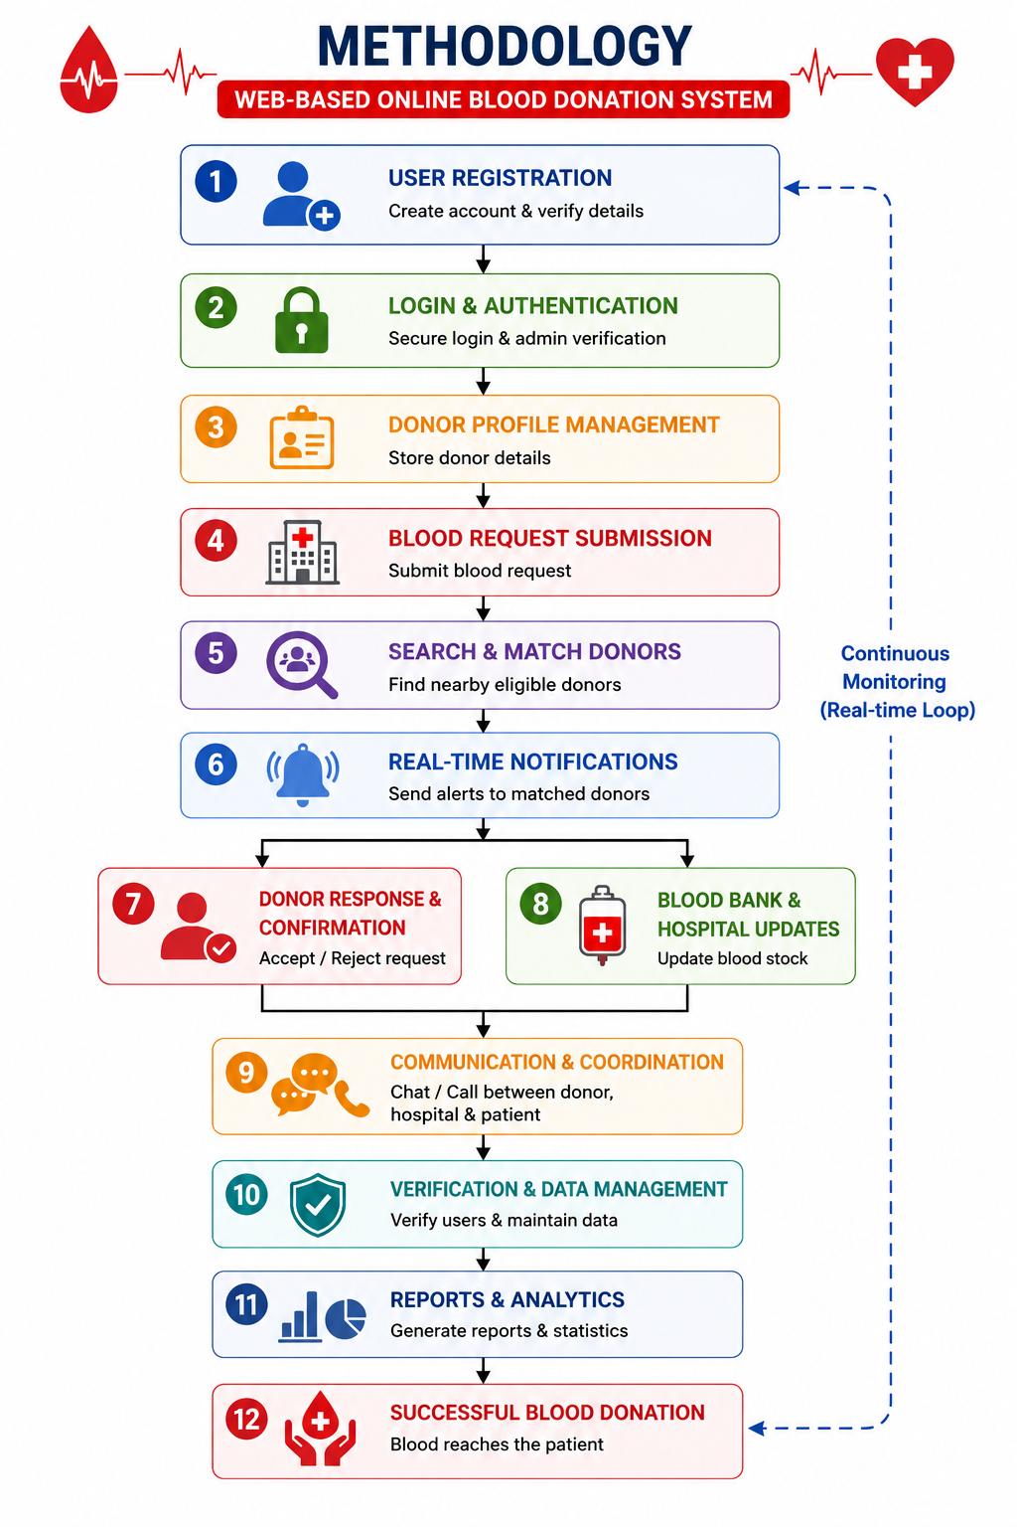
Vidya Vikas Institute of Engineering and Technology, Mysuru
Department of Computer Science and Engineering
METHODOLOGY
2025-2026

Slide 11
Vidya Vikas Institute of Engineering and Technology, Mysuru
Department of Computer Science and Engineering
SOFTWARE REQUIREMENTS
Operating System: Windows 10 / Windows 11 / Linux
Frontend: HTML, CSS, JavaScript, Bootstrap / React.js
Backend: Python / PHP / Node.js
Database: MySQL / MongoDB / Firebase
2025-2026

Slide 12
Vidya Vikas Institute of Engineering and Technology, Mysuru
Department of Computer Science and Engineering
HARDWARE REQUIREMENTS
• Processor: Intel i3/i5 or higher • RAM : 4 GB or above • Storage: 100 GB free space • System : 64-bit Laptop/Desktop
2025-2026

Slide 13
Vidya Vikas Institute of Engineering and Technology, Mysuru
Department of Computer Science and Engineering
ADVANTAGES
Quick donor search during emergencies
• Real-time blood availability updates • Faster communication between donors and hospitals • Centralized database management • Reduces manual work and time • Location-based donor matching • Emergency notifications and alerts • Secure and verified donor information
2025-2026

Slide 14
Vidya Vikas Institute of Engineering and Technology, Mysuru
Department of Computer Science and Engineering
EXCPECTED OUTCOME
Quick identification of suitable blood donors
Real-time blood availability and donor updates
Reduced delay during emergencies
Centralized and secure donor management system
Improved communication between hospitals, donors, and blood banks
Faster response through emergency notifications
Easy access using a web-based platform
Increased efficiency and reliability in blood donation services
2025-2026

Slide 15
Vidya Vikas Institute of Engineering and Technology, Mysuru
Department of Computer Science and Engineering
REFERENCES
Smart Intelligent Web Based Online Blood Donation System Authors: Putcha Uma Pratyusha, Koganti Chaitanya, Amruth Saranam, Kotaprolu Manideep, S. Kranthi Conference: IEEE ICOSEC 2021
A Web-based Blood Bank System for Managing Records of Donors and Receipts Authors: Manvir Kaur et al. Conference: IEEE CISES 2022
Blood Bank Management System: Enhancing Security and Transparency in Blood Donation Authors: J. Nulyn Punitha Markavathi et al. IEEE Conference Paper, 2025
Design and Implementation of an Online Blood Donation System Authors: Tahiru Abdul-Gafaru, David Sanka Laar, Kennedy Kumangkem Kubuga Journal: Asian Journal of Research in Computer Science, 2024
Web Project Based Emergency E-Blood Banking Management System Authors: T. Kowsalya et al. Published: 2025
2025-2026

